Slide 1
C# Data Types & Operators
Y Raghaveder

Slide 2
AGENDA
Data Types
Value Type
Reference Type
Operators

Slide 3
The variables in C#, are categorized into the following types
Value types
The value types directly contain data
Reference types
The reference types do not contain the actual data stored in a variable, but they contain a reference to the variables.
Reference Type
Value Type
Memory
ref0
ref1
Memory
int x
int y
myObject

Slide 4
Value Types
value-types inherit directly from ValueType
simple types
enum types
struct types
All value-types are sealed
value-types cannot be null
Assignment of a value-type results in a copy of the variable

Slide 5
Simple Types
integral-types
Type | System Type | Description | Example
sbyte | System.SByte | 8-bit signed integral type | sbyte val = 12;
short | System.Int16 | 16-bit signed integral type | short val = 12;
int | System.Int32 | 32-bit signed integral type | int val = 12;
long | System.Int64 | 64-bit signed integral type | long val1 = 12; long val2 = 34L;
byte | System.Byte | 8-bit unsigned integral type | byte val1 = 12;
ushort | System.UInt16 | 16-bit unsigned integral type | ushort val1 = 12;
uint | System.UInt32 | 32-bit unsigned integral type | uint val1 = 12; uint val2 = 34U;
ulong | System.UInt64 | 64-bit unsigned integral type | ulong val1 = 12; ulong val2 = 34U; ulong val3 = 56L; ulong val4 = 78UL;
char | System.Char | 16 bit unicode character | char c = ‘a’; char c = 255;
Signed
Unsigned
Unicode

Slide 6
Simple Types (Continued)
floating-point-types
Type | System Type | Description | Example
float | System.Single | Single-precision floating point type | float val = 1.23F;
double | System.Double | Double-precision floating point type | double val1 = 1.23; double val2 = 4.56D;
Decimal
Type | System Type | Description | Example
decimal | System.Decimal | Precise decimal type with 28 significant digits | decimal val = 1.23M;
Boolean
Type | System Type | Description | Example
bool | System.Boolean | Boolean type; a bool value is either true or false | bool val1 = true; bool val2 = false;

Slide 7
structs and enums
An enumeration type is a distinct type with named constants.
Every enumeration type has an underlying type, which must be byte, sbyte, short, ushort, int, uint, long or ulong.
A struct type is a value type that can declare constants, fields, methods, properties, indexers, operators, instance constructors, static constructors, and nested types.

Slide 8
Reference Types
Classes
object (System.Object)
string
user-defined classes
Interfaces
Arrays
Delegates
delegate (System.Delegate)

Slide 9
String Type
String Type (Immutable reference type)
Type | System Type | Description | Example
string | System.String | Immutable string of 16-bit Unicode characters. | string s1 = “Hello”; string s2 = string.Empty;

Slide 10
Boxing
Value Types which are up-cast to a reference type are boxed
This is necessary because Collections hold objects
Boxing places a copy of the variable in the object
Extra information (such as type info) may be stored with the variable, the standard is not explicit

Slide 11
Boxing example
class Test
{
static void Main()
{
int i = 123;
object o = i; // boxing
int j = (int) o; // unboxing
}
}

Slide 12
Type Conversions
Implicit Conversions
Implicit conversions will occur when there is no loss of information.
Example:
using System;
class Test
{
static void Main()
{
int intValue = 123;
long longValue = intValue;
Console.WriteLine("{0}, {1}", intValue, longValue);
}
}

Slide 13
Conversions
Explicit Conversions
Explicit conversions are required when there could be loss of information.
Example:
using System;
class Test
{
static void Main()
{
long longValue = System.Int64.MaxValue;
int intValue = (int)longValue;
Console.WriteLine(“(int){0} = {1}", longValue, intValue);
}
}

Slide 14
Conversions
Explicit or Implicit?
float to Int32?
Explicit
Int32 to float?
Implicit
decimal to float?
Explicit
long to decimal?
Implicit
Int32 to UInt32?
Explicit
UInt32 to Int32?
Explicit

Slide 15
Operators in C#
C# provides a fixed set of operators, whose meaning is defined for the predefined types
Some operators can be overloaded (e.g. +)
The following table summarizes the C# operators by category
Categories are in order of decreasing precedence
Operators in each category have the same precedence

Slide 16
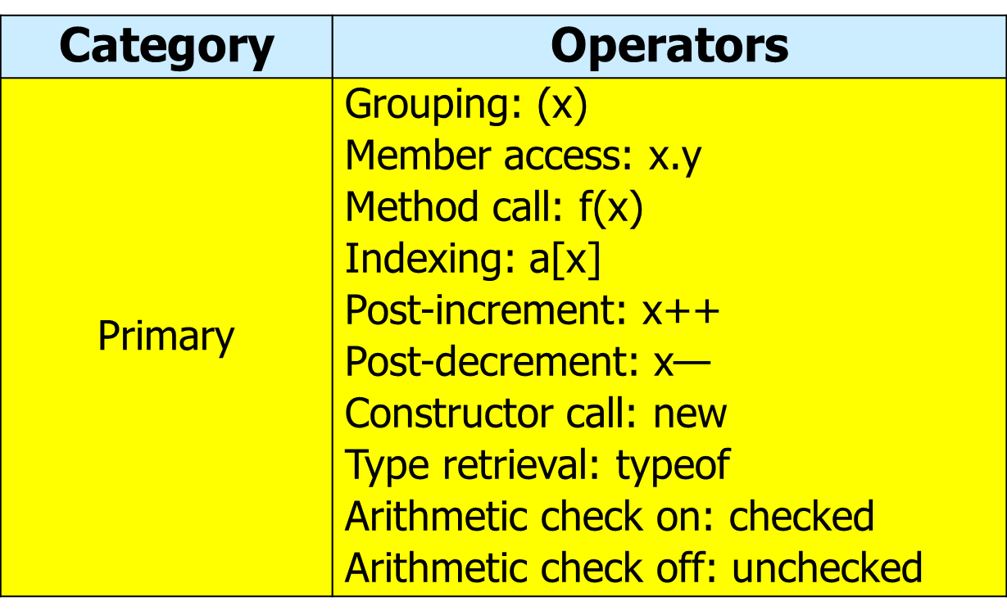
Operators and Precedence

Slide 17
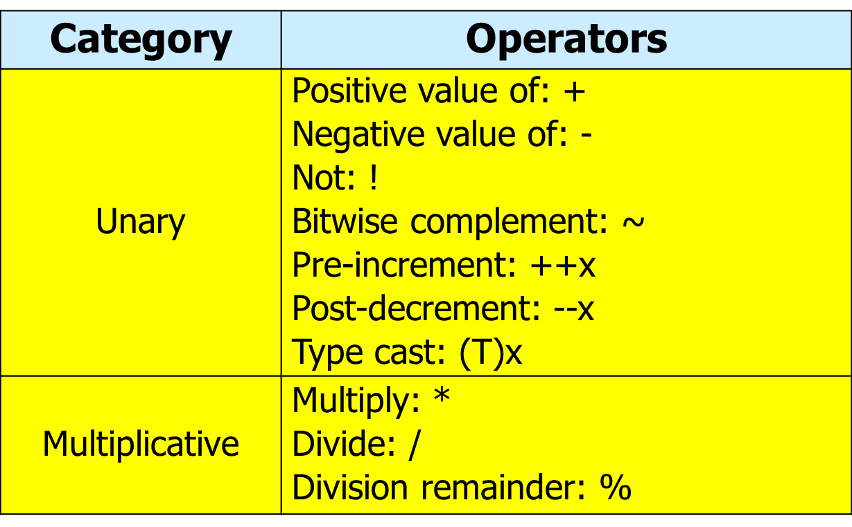
Operators and Precedence

Slide 18
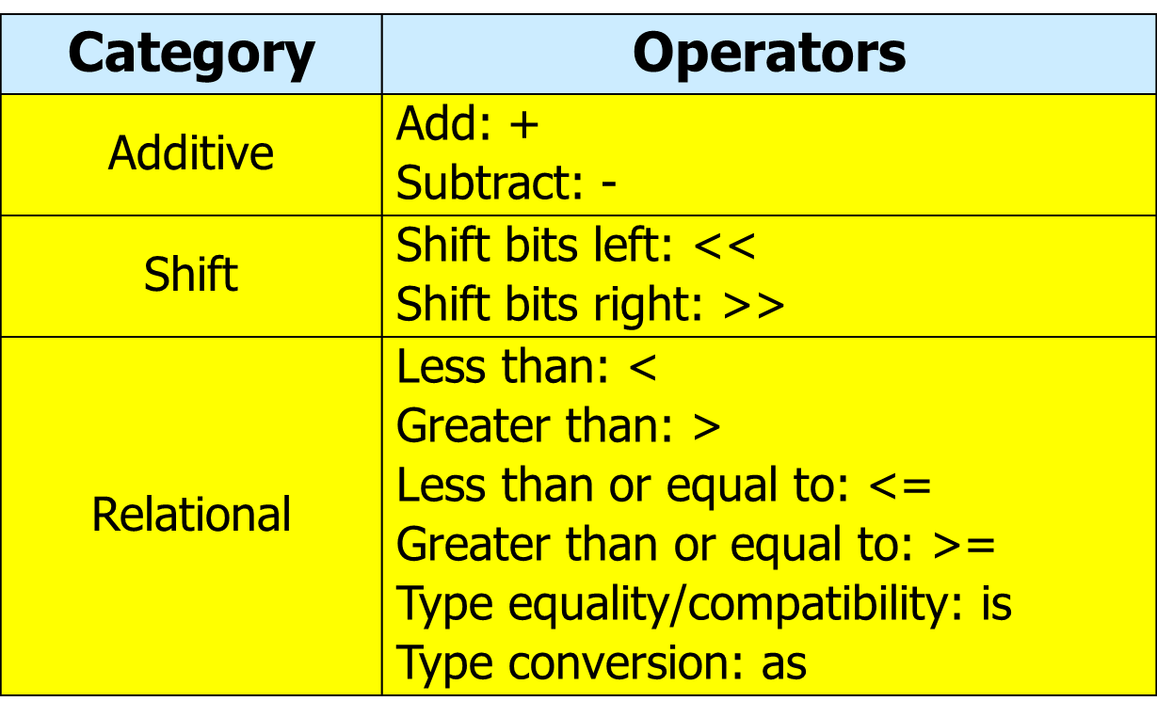
Operators and Precedence

Slide 19
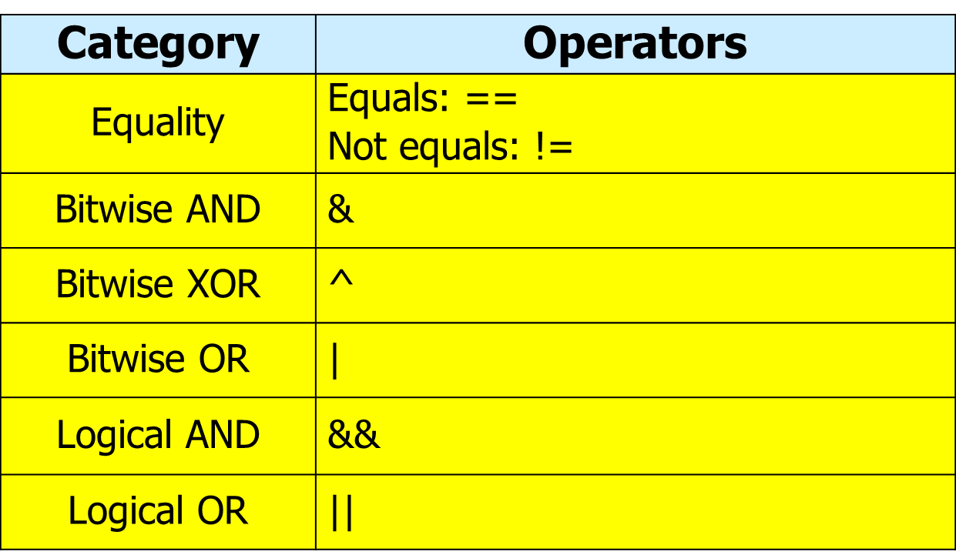
Operators and Precedence

Slide 20
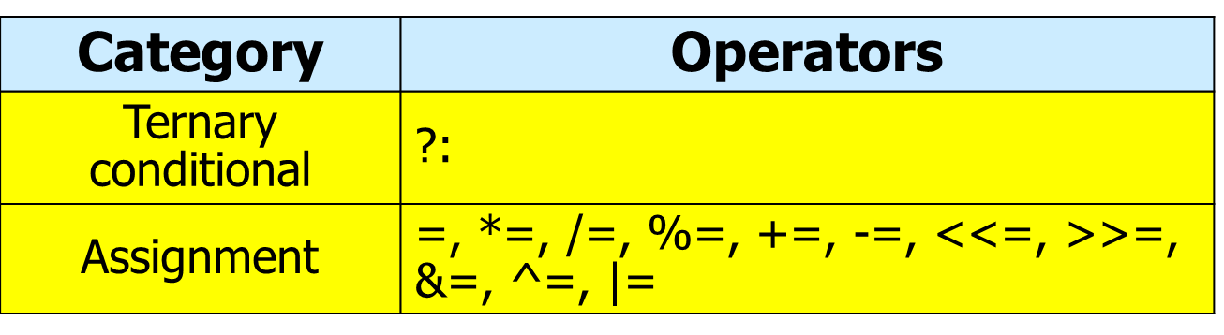
Operators and Precedence

Slide 21
Q &A

Slide 22
Thank You

